Slide 1
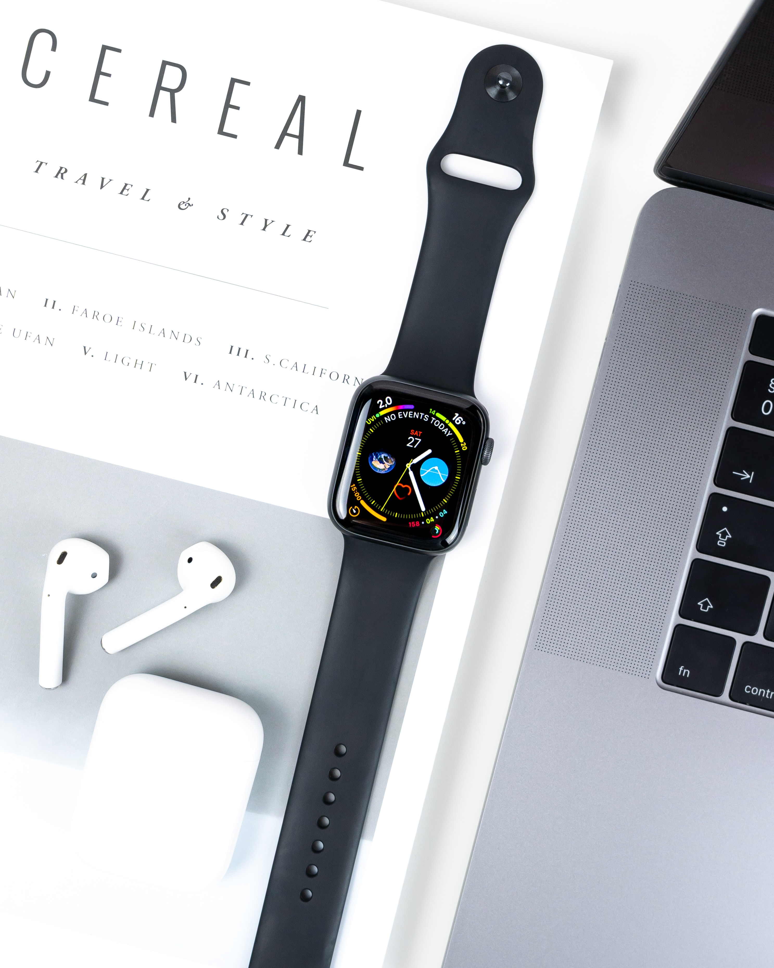

Technology and the Contemporary Environment
CGEO 702

Slide 2

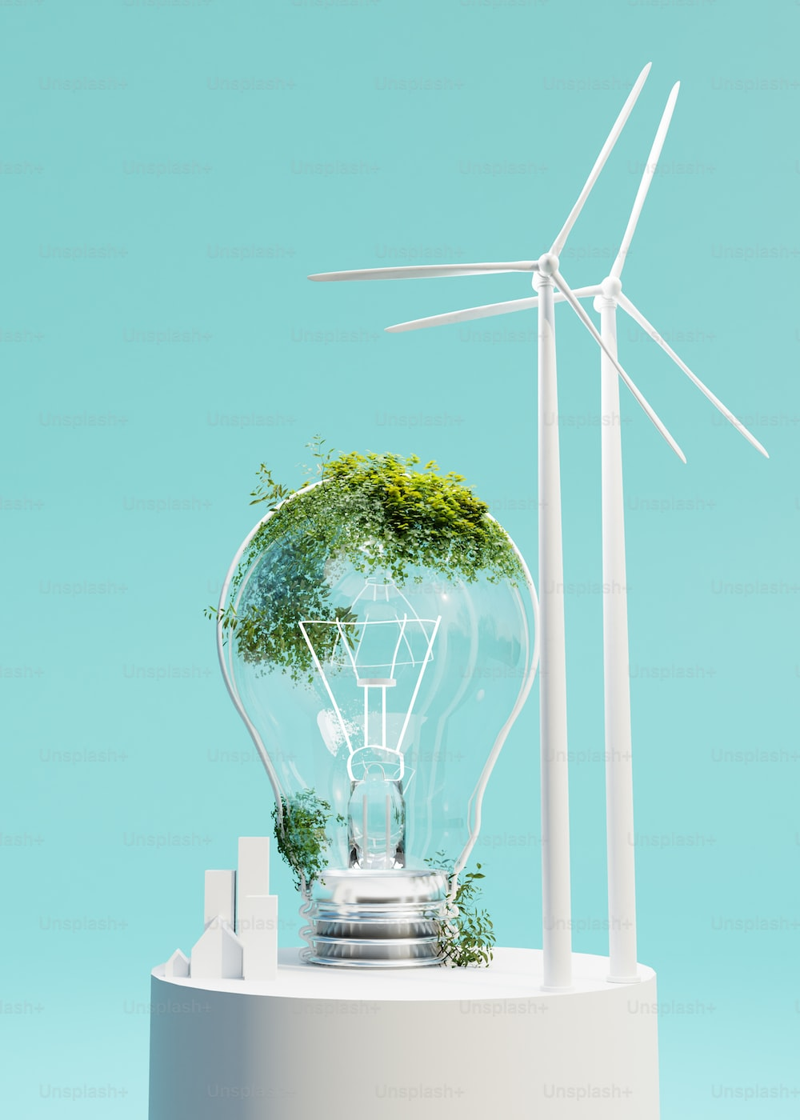
Technology and Contemporary Environment
Sustainability, Sustainable Development and the Circular Economy ● An Overview

Slide 3
Technology and Contemporary Environment
Welcome and Introduction
Before we begin…let me introduce myself!!
Hugh Anthony Simmonds, PhD
Department of Geography and Environmental Studies, Faculty of Arts, Jorgensen Building
Office: JOR 607
Email: hugh.simmonds@torontomu.ca

Slide 4
Technology and the Contemporary Environment
Welcome and Introduction
OFFICE HOURS | BY APPOINTMENT
Mondays : 9:00am – 11:00am
Office : JOR 607
Where : Departure of Geography and
Environmental Studies, Faculty of Arts
Place : Jorgensen Building
(Victoria St. & Gerrard St. East)

Slide 5
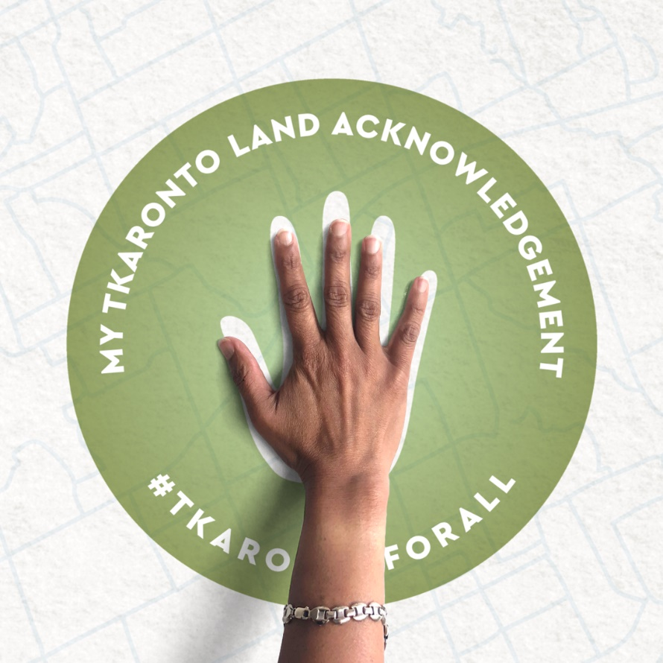
Technology and the Contemporary Environment
Land Acknowledgement
“Toronto is in the ‘Dish With One Spoon Territory’. The Dish With One Spoon is a treaty between the Anishinaabe, Mississaugas and Haudenosaunee that bound them to share the territory and protect the land. Subsequent Indigenous Nations and peoples, Europeans and all newcomers have been invited into this treaty in the spirit of peace, friendship and respect.”
Awakenings: We Were Always Here | Acknowledgment (A film by Jonathan Elliott, 2020)
https://www.youtube.com/watch?v=3X4MYbJvLUI

Slide 6

Learning Objectives
Learning Objectives

Slide 7
Technology and the Contemporary Environment
Learning Objectives
Explain the concept of sustainability and some of the key approaches to sustainable development.
Describe and assess some sustainable development initiatives and identify major sustainability challenges.
Explore and understand the circular economy and its relevance and tremendous potential to solve environmental challenges.

Slide 8
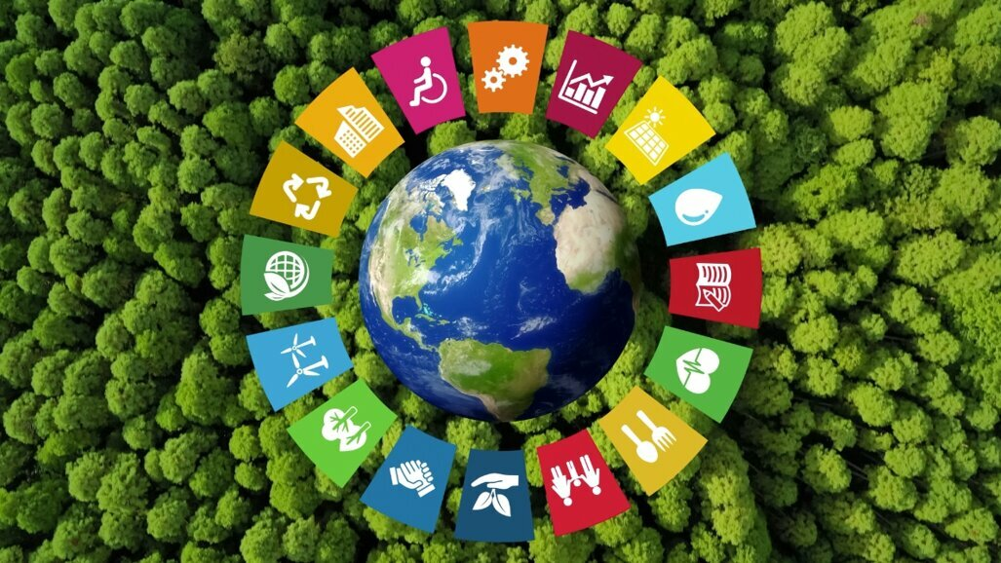
Technology and the Contemporary Environment
Learning Objectives | Introductory Video
for Tomorrow – Manifesto
https://www.youtube.com/watch?v=pJ00cRRrEjI

Slide 9
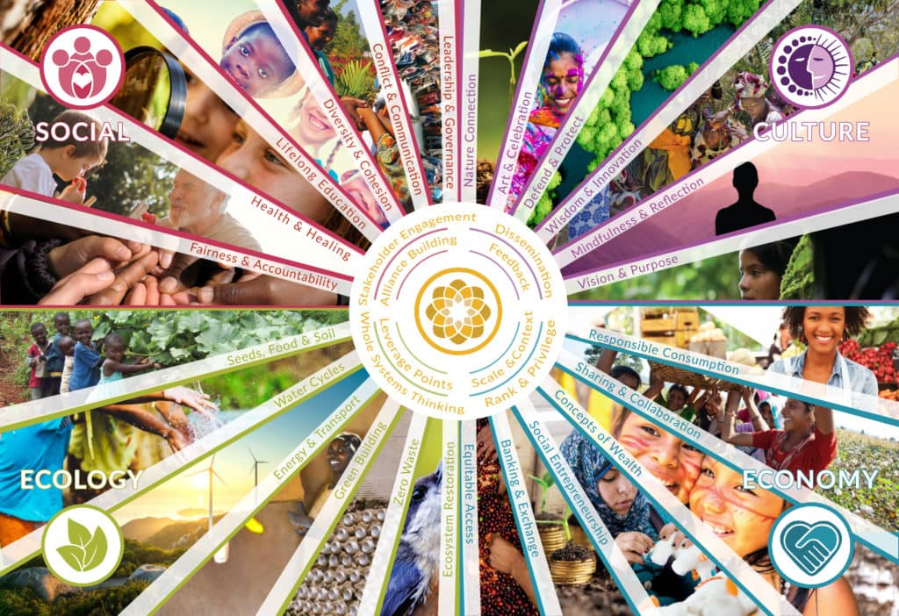
Technology and the Contemporary Environment
Sustainability and Sustainable Development

Slide 10
Technology and the Contemporary Environment
Sustainability and Sustainable Development
Considering sustainability vs. sustainable development is essential to understanding these two crucial concepts. This understanding plays a critical role in helping solve some of the challenges in the world today, such as extreme weather, poverty, climate change, armed conflicts, and inequity across society.

Slide 11

Technology and the Contemporary Environment
Sustainability

Slide 12
Technology and the Contemporary Environment
Sustainability and Sustainable Development
What do people mean by sustainability?
to sustain human institutions and ecological systems in a healthy and functional state
Sustainable development requires an integrated approach that takes into consideration environmental concerns along with economic development.
Sustainability is far from a new concept. Indigenous peoples have practiced elements of sustainable living for generations by being in tune with the natural environment and its limits, cycles, and changes.

Slide 13
Technology and Contemporary Environment
Sustainability and Sustainable Development
The United Nations (UN) has defined sustainable development as:
“Development that meets the needs of the present without compromising the ability of future generations to meet their own needs.”
Triple bottom line = the goal of modern sustainable development, including finding ways to promote
social justice
economic well-being
environmental quality

Slide 14
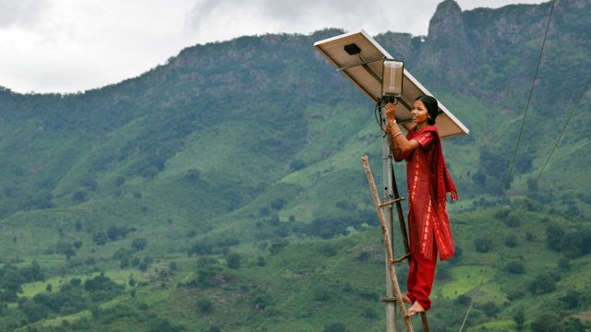
Technology and the Contemporary Environment
Sustainable Development

Slide 15
Technology and the Contemporary Environment
Sustainability and Sustainable Development
The concepts of sustainability and sustainable development have acquired great relevance in scientific research about environmental issues, policies linked to environmental management, and industrial and agricultural production, among others.
Sustainability and sustainable development also play a central role in business, across industries and in almost every field. Trends suggest consumers prefer to buy products from companies that subscribe to the pillars of sustainability and sustainable development.

Slide 16
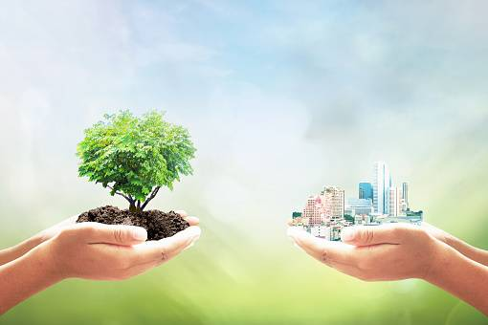

Technology and the Contemporary Environment
Sustainability and Sustainable Development
Sustainability and sustainable development are often used interchangeably. Both speak to the danger of consuming resources faster than they can be replenished. However, a close look at sustainability vs. sustainable development reveals nuances that differentiate them.

Slide 17
Technology and the Contemporary Environment
Sustainability and Sustainable Development
Sustainability is a broad term that describes managing resources without depleting them for future generations. This concept goes beyond environmental sustainability, which concerns earth’s natural resources, to include economic and social sustainability, which relate to meeting people’s current economic and social needs without compromising future generations.
Sustainable development describes the processes for improving long-term economic well-being and quality of life without compromising future generations’ ability to meet their needs.

Slide 18
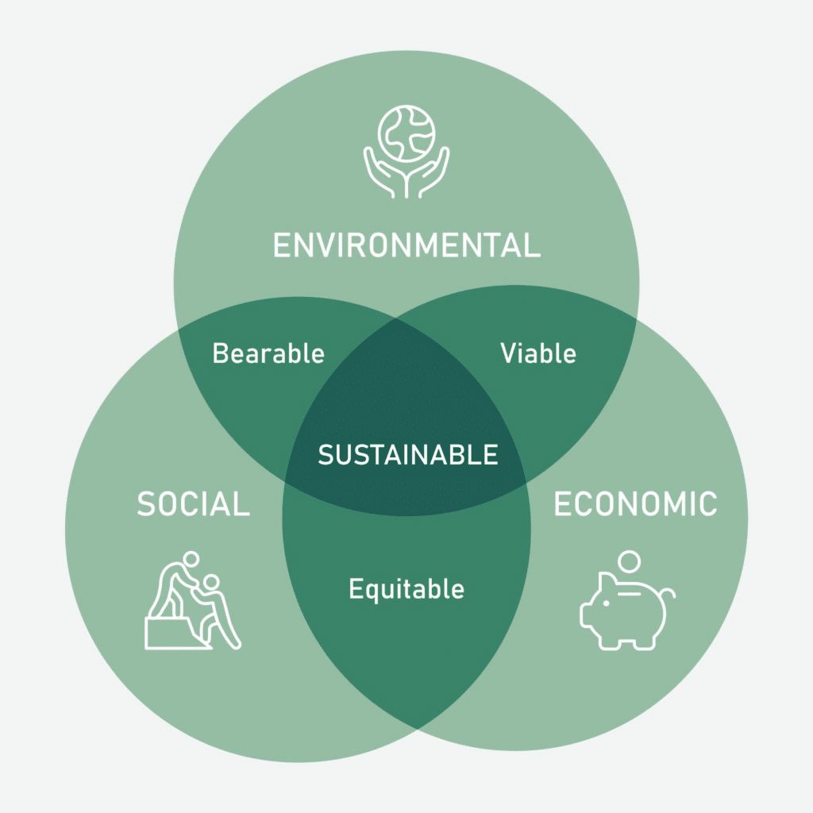
Technology and the Contemporary Environment
Sustainability and Sustainable Development
The Pillars of Sustainability and Sustainable Development
Sustainability encompasses three pillars: environmental, social and economic, also represented as profits, planet, and people.

Slide 19
Technology and the Contemporary Environment
Sustainability and Sustainable Development
Environmental/planet 一 In business, reducing carbon footprints, waste, and water usage while maximizing energy efficiency can provide both environmental and financial benefits, and shows responsiveness to community opinion. According to Pew Research, 63% of Americans believe that climate change affects their local community.
Social 一 The social pillar of sustainability focuses on the interrelationship of systems and processes that support the creation of healthy and livable communities that can sustain themselves. In business, social sustainability initiatives often include promoting fair labor practices and wages; employee health, safety, wellness, and work-life balance; and diversity and equity.

Slide 20
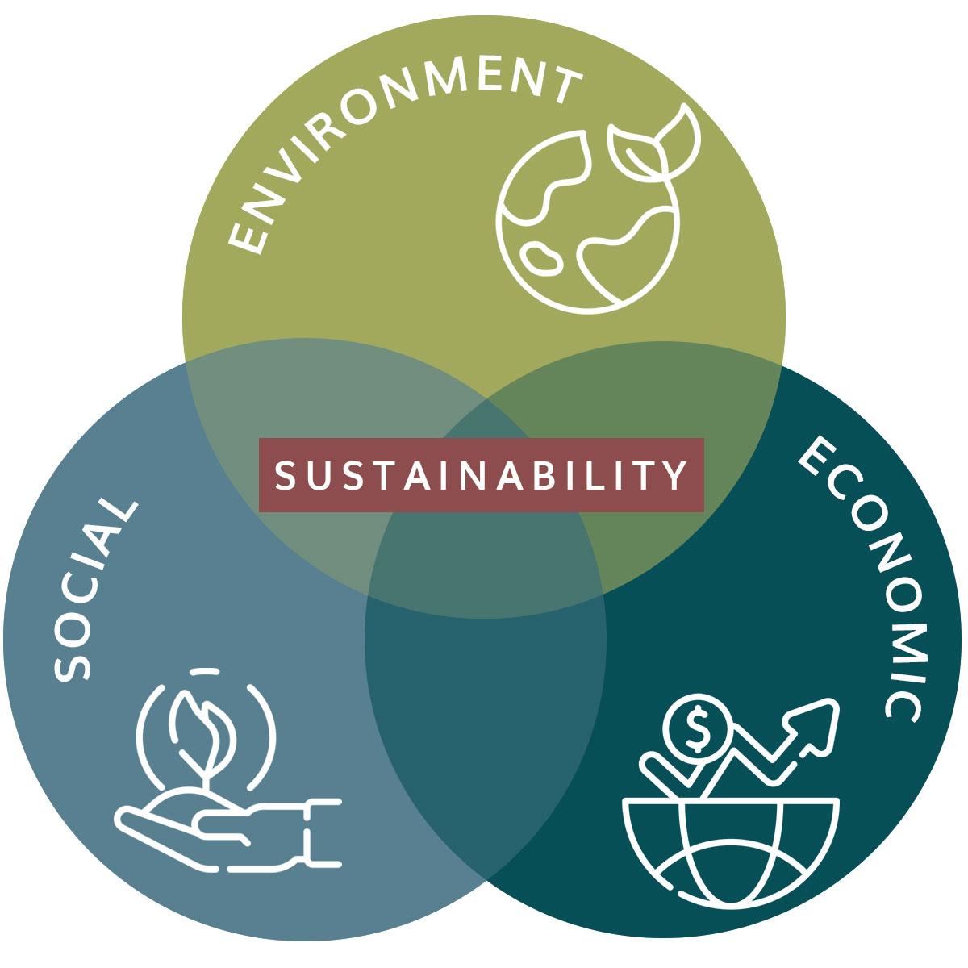
Technology and the Contemporary Environment
Sustainability and Sustainable Development
Economic 一 This pillar centers on the idea of an efficient and responsible use of resources that leads to sustainability and long-term profitability. In business, profitability can equal longevity. In other words, transitioning to a sustainable business can improve a company’s chances of operating over the long term.

Slide 21
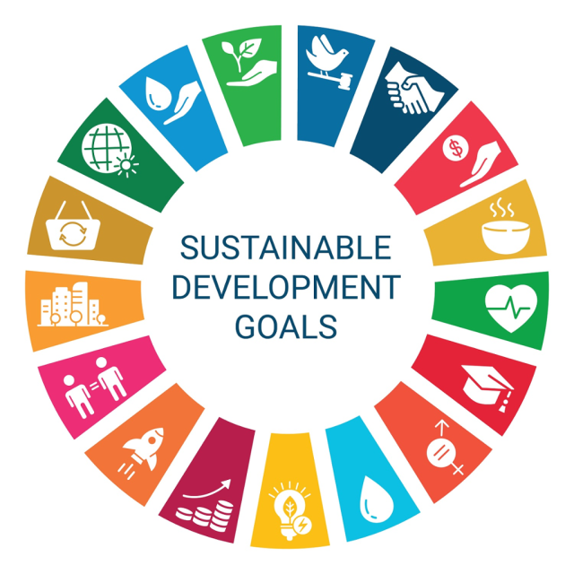
Technology and the Contemporary Environment
Sustainability and Sustainable Development
Integrating sustainability and sustainable development is fundamental to designing effective short- and long-term strategies. Sustainability professionals can apply their understanding of these pillars to specific issues, such as problems related to climate change or biodiversity. They can also help organizations align themselves with the United Nations sustainable development goals (SDGs), 17 interconnected goals focused on creating a more sustainable future for all.

Slide 22
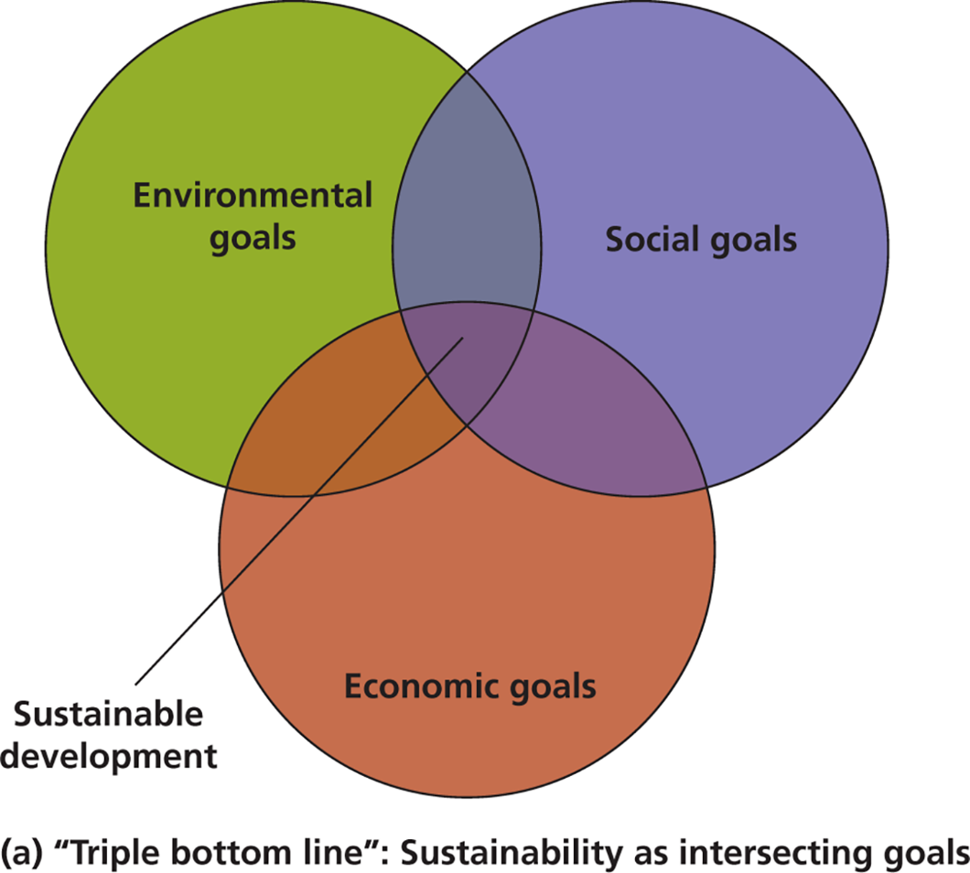
Technology and Contemporary Environment
The pillars of sustainability are often visualized as a Venn diagram, where the three pillars, represented as a circle, intersect to share a common center 一 the area of sustainability. This visual illustrates that sustainability can only be achieved when all three pillars are addressed together.

Slide 23
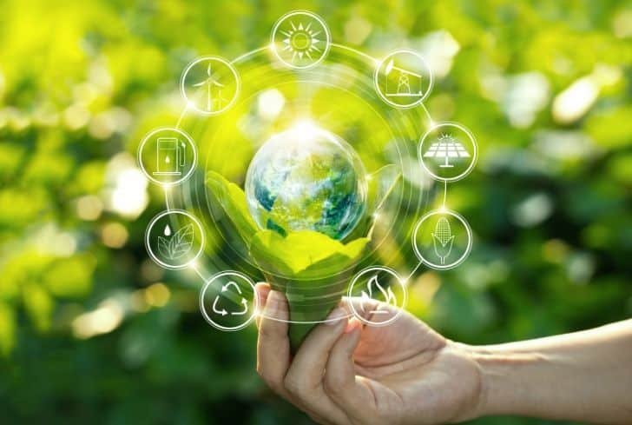
Technology and the Contemporary Environment
Sustainability and Sustainable Development
Netflix + Sustainability - Net Zero By the End of 2022
https://www.youtube.com/watch?v=2NqjkgNsJLw

Slide 24
Technology and the Contemporary Environment
Sustainable development aims to achieve a triple bottom line
The Millennium Development Goals:
1. Eradicate extreme poverty and hunger.
2. Achieve universal primary education.
3. Promote gender equality and empower women.
4. Reduce child mortality.
5. Improve maternal health.
6. Combat HIV/AIDS, malaria, and other diseases.
7. Ensure environmental sustainability.
8. Develop a global partnership for development.

Slide 25

Technology and the Contemporary Environment
Strategies for
Sustainability and Sustainable Development
A Look at the Sustainable Development Goals
https://www.youtube.com/watch?v=5G0ndS3uRdo

Slide 26
Technology and the Contemporary Environment
Sustainability and Sustainable Development
Although progress was made, some goals saw more progress than others:
Environmental degradation is a major barrier to achieving the Millennium Development Goals.
Investing in environmental assets and management is vital to relieving poverty, hunger, and disease.
Forests are disappearing at an alarming rate.
Global emissions of carbon dioxide have increased.
The targeted reduction in the rate of biodiversity and ecosystem loss has not been achieved.
Progress has been made in reducing ozone-depleting substances and in making improved water sources more available.

Slide 27
Technology and the Contemporary Environment
Sustainability and Sustainable Development
Environmental protection can enhance economic opportunity
Achieving sustainable development goals as a global community requires adopting integrated approaches, finding new synergies, developing new technologies, and sometimes just thinking differently.
For example, reducing resource consumption and waste isn’t just a way to meet an environmental goal; it often saves money, too, as many businesses, municipalities, colleges, and universities discover when they embark on sustainability initiatives. Sometimes savings accrue immediately, and other times an upfront investment brings long-term savings.

Slide 28
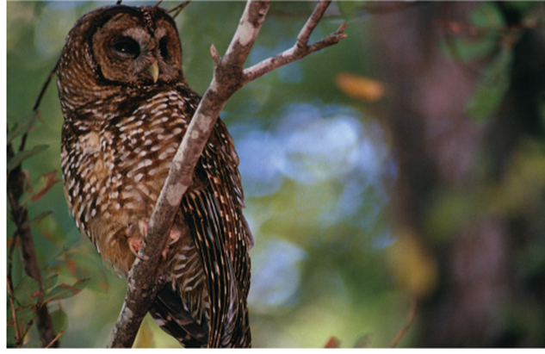
Technology and the Contemporary Environment
Sustainability and Sustainable Development
Environmental protection can enhance economic opportunity (cont’d)
Reducing consumption and waste saves money
Provides new types of employment
Logging of old-growth forest vs. protection for the northern spotted owl
Cost local loggers their jobs
Jobs at risk when companies cut and then leave
Regions that act to protect their environment are generally the ones that retain and increase their wealth and quality of life

Slide 29
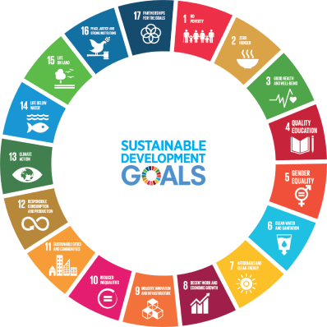
Technology and the Contemporary Environment
Sustainability and Sustainable Development
The UN 17 Sustainable Development Goals (SDGs) replace the Millennium Development Goals (MDGs) which mobilized the entire world between 2000 and 2015 behind a common program for developing countries.
The 17 SDGs were established in 2015 to build on this momentum to promote prosperity while protecting the environment.

Slide 30
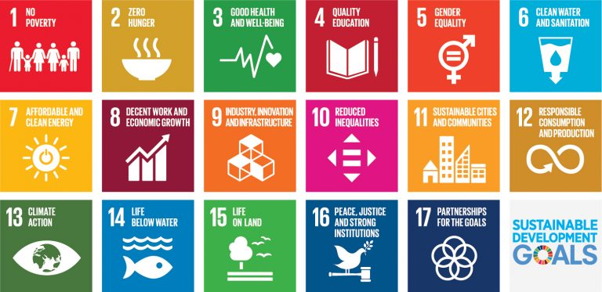
Technology and the Contemporary Environment
Sustainability and Sustainable Development
To ensure the world remains focused on the long-term benefits that will be brought about by the SDGs, the United Nations is calling for a Decade of Action — to accelerate sustainable solutions to all the world's biggest challenges by 2030.

Slide 31
Technology and the Contemporary Environment
Strategies for
Sustainability and Sustainable Development
What is sustainable development?
https://www.youtube.com/watch?v=7V8oFI4GYMY&t=10s

Slide 32
Technology and the Contemporary Environment
Environment and Society
All levels of society have a responsibility to protect the quality of our common environment. These obligations are a central aspect of the social contract by which enlightened communities function.
The role of government is an overarching one, because it is empowered to regulate the activities of itself, the private sector, non-governmental organizations, and individuals.
The role of environmental non-governmental organizations (ENGOs) is to lobby government and industry about issues, to raise public awareness, and increasingly (because of shortages of governmental capability), to raise funds that can be used to prevent and repair environmental damage. Finally, all individual citizens have an obligation to live their lives in an environmentally responsible manner.

Slide 33
Technology and Contemporary Environment
Sustainability and Sustainable Development
Economic value of sustainable ecosystems exceeds value of those that have been converted.
“We must realize that when basic needs have been met, human development is primarily about being more, not having more.”
– from ‘The Earth Charter’

Slide 34
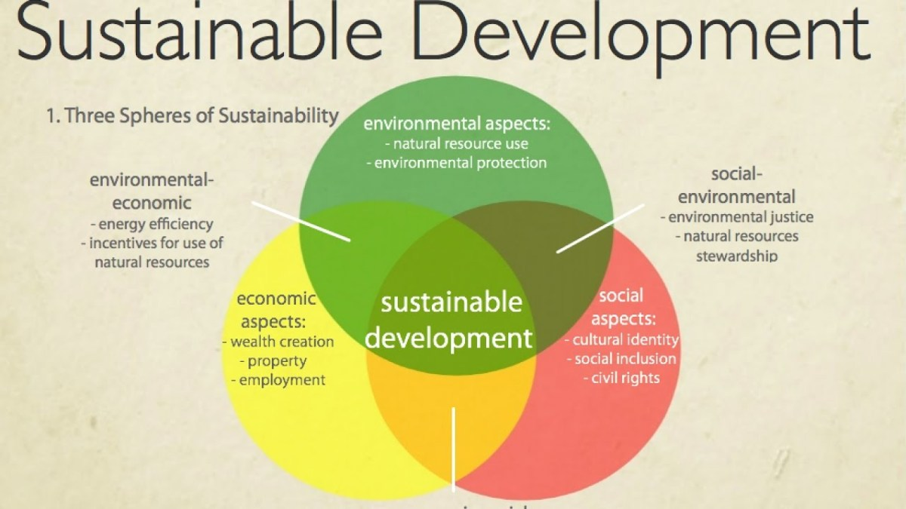
Technology and the Contemporary Environment
Sustainability and Sustainable Development
Three Dimensions of Sustainability
Although sustainability is linked to the environmental movement, the notion that it is only focused on the environment is a misconception. Sustainability is based on three dimensions:

Slide 35
Technology and the Contemporary Environment
Sustainability and Sustainable Development
Environmental Sustainability occurs when humanity’s rate of consumption does not exceed nature’s rate of replenishment and when humanity’s rate of generating pollution and emitting greenhouse gases does not exceed nature’s rate of restoration.
Social Sustainability is the ability of a society to uphold universal human rights and meet people's basic needs, such as healthcare, education, and transportation. Healthy communities ensure personal, labour, and cultural rights are respected and all people are protected from discrimination.

Slide 36
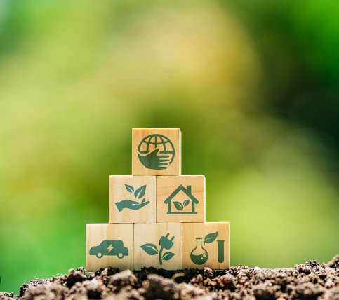
Technology and the Contemporary Environment
Sustainability and Sustainable Development
Economic Sustainability is the ability of human communities around the world to maintain their independence and have access to the resources required to meet their needs, meaning that secure sources of livelihood are available to everyone.

Slide 37

Sustainability and Sustainable Development
What is Sustainability?
https://www.youtube.com/watch?v=zx04Kl8y4dE&t=1s

Slide 38
Technology and the Contemporary Environment
We are not separate from our environment
Philosophers have said that the perceived dichotomy between humans and nature is the root of all our environmental problems. It is easy to feel disconnected from nature.
A few centuries or even decades ago, most of the world could name and describe in detail the species that lived near them. Modern life has made it difficult to keep and maintain ties with the natural environment.
Once we learn to consider where things come from, it is easier to see how people are part of the environment

Slide 39
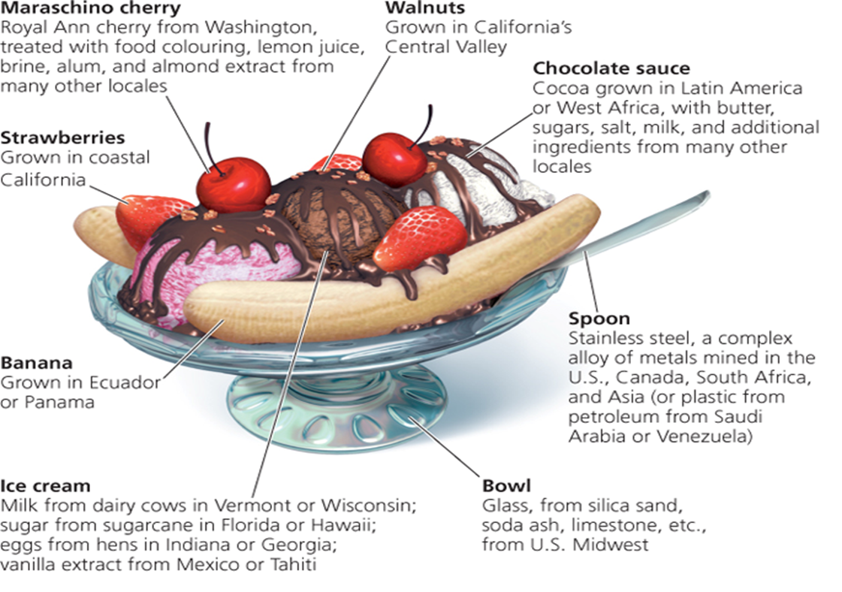
Technology and the Contemporary Environment
Consider a thoroughly un-“natural” invention of the human species: the banana split in which each and every element has ties to the resources of the natural environment, and each exerts environmental impacts.

Slide 40

Technology and the Contemporary Environment
Sustainability and Sustainable Development
Sustainable solutions to environmental problems are numerous, and we have seen many specific examples throughout this course. The challenges lie in being imaginative enough to think of solutions, and being shrewd and dogged enough to overcome political or economic obstacles that may lie in the path of their implementation. Let’s examine some of the strategies, tools, and approaches that we can use to help us move toward a sustainable future.

Slide 41
Technology and Contemporary Environment
Sustainability and Sustainable Development
We can follow a number of strategies toward sustainable solutions
Engage politically and exercise our power as consumers
Rethink economic growth and quality of life
Stabilize population
Encourage the development of green technologies
Mimic natural systems by promoting closed-loop industrial processes
Think in the long term
Enhance local self-sufficiency, yet embrace some aspects of globalization
Use systems thinking to find holistic solutions
Promote research, education, and awareness

Slide 42
Technology and the Contemporary Environment
Sustainability and Sustainable Development
Political engagement and purchasing power:
Require leaders and policy-makers to usher sustainable solutions through
Individually and collectively we can guide political leaders to enact policies for sustainability
You can exercise your power at the ballot box in a democratic country
We can wield influence through choices we make as consumers

Slide 43
Technology and the Contemporary Environment
Sustainability and Sustainable Development
Rethinking growth and quality of life:
Economic growth is merely a tool to attain the real goal of maximizing human happiness
We cannot attain long-term happiness by endlessly expanding our economy
We need to incorporate external costs into market prices of goods and services
Green taxes and phasing out harmful substances could encourage sustainability

Slide 44

Technology and the Contemporary Environment
Sustainability and Sustainable Development
Rethinking growth and quality of life:
Economic growth is driven by consumption
We believe that more is better
Consumption of limited resources cannot continue
Affluenza – material wealth with affluent people; accumulation of possessions

Slide 45
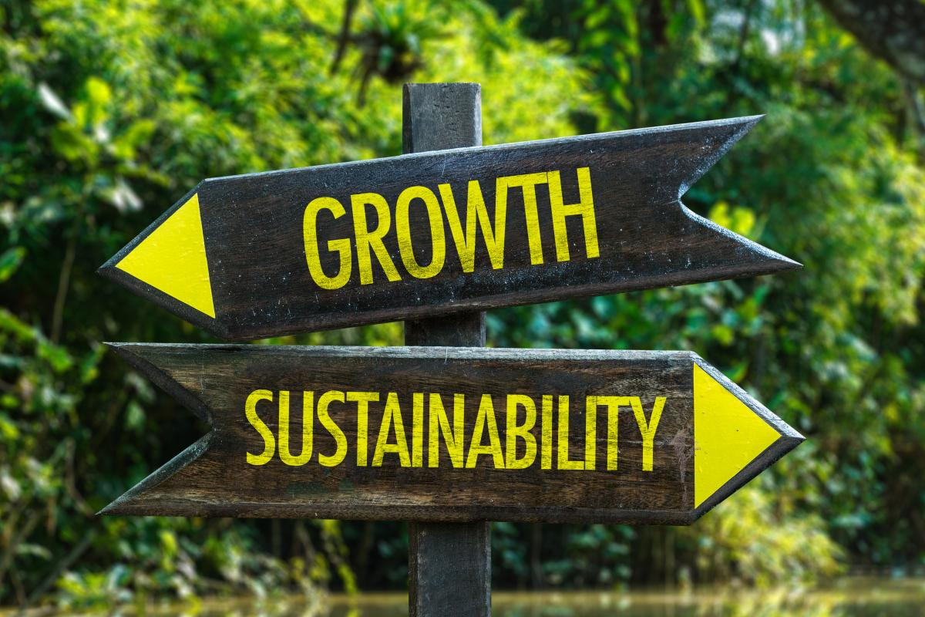
Technology and the Contemporary Environment
Sustainability and Sustainable Development
Rethinking growth and quality of life:
We can reduce consumption while enhancing our quality of life by:
Improving technology and efficiency in industry
Developing a sustainable manufacturing system
Modify our behavior, attitudes, and lifestyles to minimize consumption

Slide 46
Technology and the Contemporary Environment
Sustainability and Sustainable Development
Population stability:
Continued human population growth is not sustainable
Technology has expanded the Earth’s carrying capacity
Sooner or later, growth will end, but how?
War, plagues, famine, voluntary means?
The demographic transition may help developing countries, as it helped developed countries

Slide 47
Technology and the Contemporary Environment
Sustainability and Sustainable Development
Green technologies:
Technology has spurred population increase
Agricultural revolution, advances in medicine and health
Technology magnifies our impact on Earth (either positive or negative)
The IPAT equation
Short-sighted uses of technology have created a mess
But wiser use of green technology can help us get out
Developed countries have exported technologies to developing countries.

Slide 48

Technology and the Contemporary Environment
Nature makes human development possible but our relentless demand for the earth’s resources is accelerating extinction rates and devastating the world’s ecosystems.
Joyce Msuya, Deputy Executive Director,
United Nations Environment Programme

Slide 49
Technology and the Contemporary Environment
Because many of Earth’s natural resources are limited and nonrenewable, consumption cannot continue growing forever. Eventually, if we do not shift to more sustainable resource use, per capita consumption will drop for rich and poor alike as resources dwindle. Critics may scoff at the notion that resources are limited, but we must remember that our perspective in time is limited, and that our consumption is taking place within an extraordinarily brief slice of time in the long course of history. Our lavishly consumptive lifestyles are a brand-new phenomenon on Earth. We are enjoying the greatest material prosperity in all of history, but if we do not find ways to make our wealth sustainable, the party may not last much longer. (United Nations)

Slide 50
Technology and the Contemporary Environment
Mimicking natural systems:
Environmental systems operate in cycles
Feedback loops and circular material flows
Output is recycled into input
Human systems are linear
Raw materials are processed, which generates waste
Virtually all products can be recycled, given the right technology
The ultimate vision is to generate no waste

Slide 51
Technology and the Contemporary Environment
Long-term perspectives:
The best long-term solution is not always the best short-term solution
Unfortunately environmental problems can be resolved only by long-term periods
Costs of addressing problems are short term
Benefits are long term
Businesses may act according to either short or long term
A business committed to long-term operations has an incentive to sustain environmental quality

Slide 52
Technology and the Contemporary Environment
The local and the global perspectives:
As our societies become more globally interconnected, we experience a diversity of impacts, positive and negative.
To many people, encouraging local self-sufficiency is an important element of building sustainable societies.
When people feel closely tied to the area in which they live, they tend to value the area and seek to sustain its environment and human communities.
This line of reasoning is frequently made in relation to locally based organic or sustainable agriculture.
Those who view globalization in a negative light generally cite the homogenization of the world’s cultures, by which a few cultures and worldviews displace many others.

Slide 53
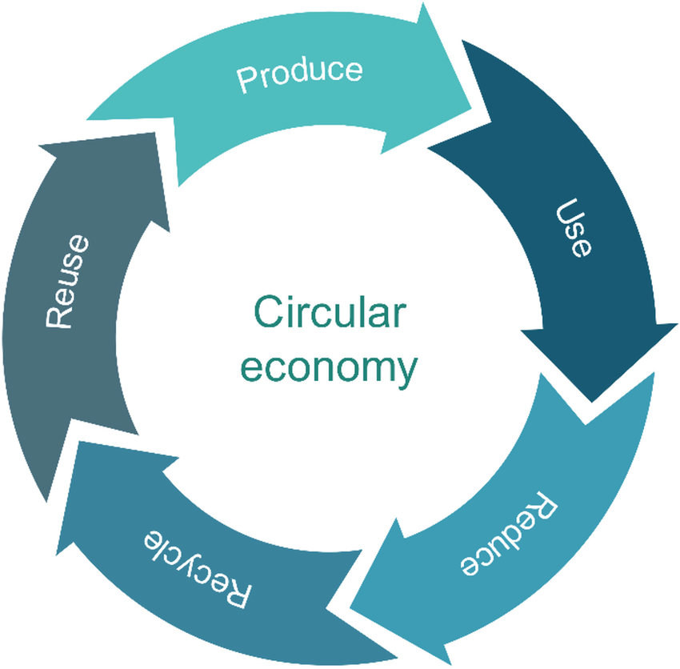
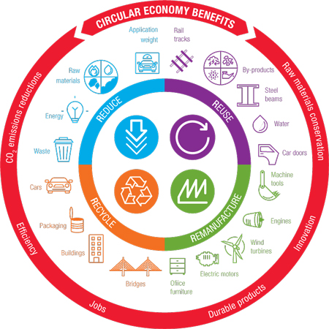
Technology and the Contemporary Environment
The Circular Economy
What is the Circular Economy?
https://www.youtube.com/watch?v=nrzwAxcU1bw

Slide 54
Technology and the Contemporary Environment
A circular economy entails markets that give incentives to reusing products, rather than scrapping them and then extracting new resources. In such an economy, all forms of waste, such as clothes, scrap metal and obsolete electronics, are returned to the economy or used more efficiently. This can provide a way to not only protect the environment, but use natural resources more wisely, develop new sectors, create jobs and develop new capabilities.
United Nations Conference on Trade and Development (UNCTAD)

Slide 55
Technology and the Contemporary Environment
The Circular Economy
In our current economy, we take materials from the Earth, make products from them, and eventually throw them away as waste – the process is linear. In a circular economy, by contrast, we stop waste being produced in the first place.
It is underpinned by a transition to renewable energy and materials.
A circular economy decouples economic activity from the consumption of finite resources. It is a resilient system that is good for business, people and the environment.

Slide 56
Technology and the Contemporary Environment
The Circular Economy
The circular economy establishes a more sustainable production and consumption model in which raw materials are kept longer in production cycles and can be used repeatedly, therefore generating much less waste.
The circular economy, the essence of this model is that resources are kept in the economy for as long as possible, making it possible to use the waste we generate as raw material for other industries.

Slide 57
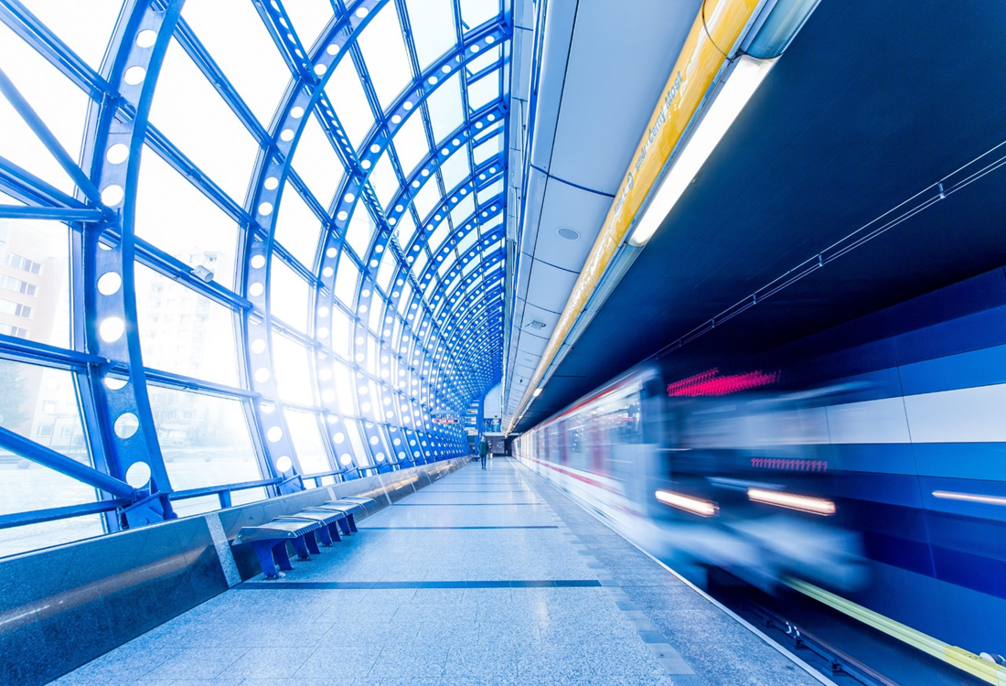
Technology and the Contemporary Environment
The Circular Economy
What is the circular economy? | CNBC Explains https://www.youtube.com/watch?v=__0Spwj8DkM

Slide 58
Technology and the Contemporary Environment
The Circular Economy
What is the circular economy?
The circular economy is an evolution of the way the world produces and consumes both goods and services.
The circular model redefines the economy around principles of designing out waste and pollution, keeping products and materials in use for as long as possible.
Equally vital are restoring the world’s wilderness, building regenerative agricultural systems, using renewable materials, and shifting to renewable energy sources.

Slide 59
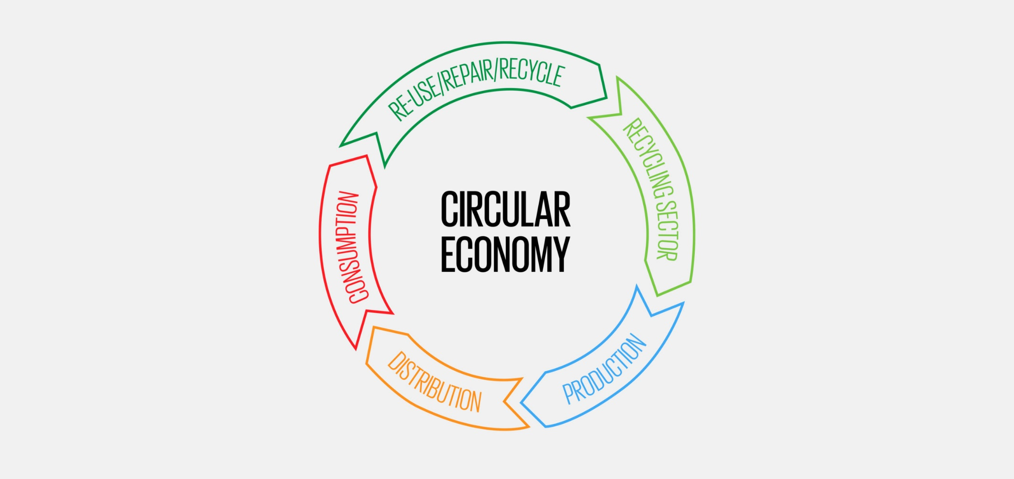
Circular Economy and Sustainability
Explaining the Circular Economy and How Society Can Re-think Progress |
Animated Video Essay
https://www.youtube.com/watch?v=zCRKvDyyHmI

Slide 60
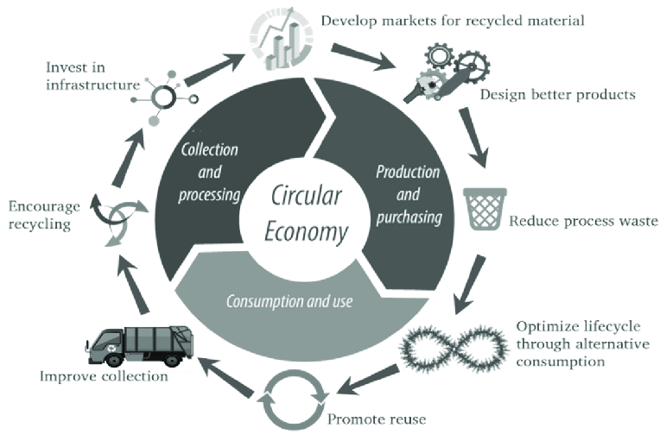
Technology and the Contemporary Environment
The Circular Economy
The circular economy, by contrast, is one that is "restorative and regenerative by design, and aims to keep products, components, and materials at their highest utility and value at all times" (Ellen MacArthur Foundation, 2013). The circular economy philosophy is an emerging field of study, promoting a systemic, cross-disciplinary approach. This course explores how these various disciplines come together to promote a sustainable economic model.

Slide 61
Technology and Contemporary Environment
The Circular Economy
A way to transform our system
What will it take to transform our throwaway economy into one where waste is eliminated, resources are circulated, and nature is regenerated?
The circular economy gives us the tools to tackle climate change and biodiversity loss together, while addressing important social needs.
It gives us the power to grow prosperity, jobs, and resilience while cutting greenhouse gas emissions, waste, and pollution.

Slide 62
Technology and the Contemporary Environment
The Circular Economy
How the circular economy works?
The butterfly diagram: visualizing the circular economy
The circular economy system diagram, known as the butterfly diagram, illustrates the continuous flow of materials in a circular economy. There are two main cycles – the technical cycle and the biological cycle. In the technical cycle, products and materials are kept in circulation through processes such as reuse, repair, remanufacture and recycling. In the biological cycle, the nutrients from biodegradable materials are returned to the Earth to regenerate nature.

Slide 63
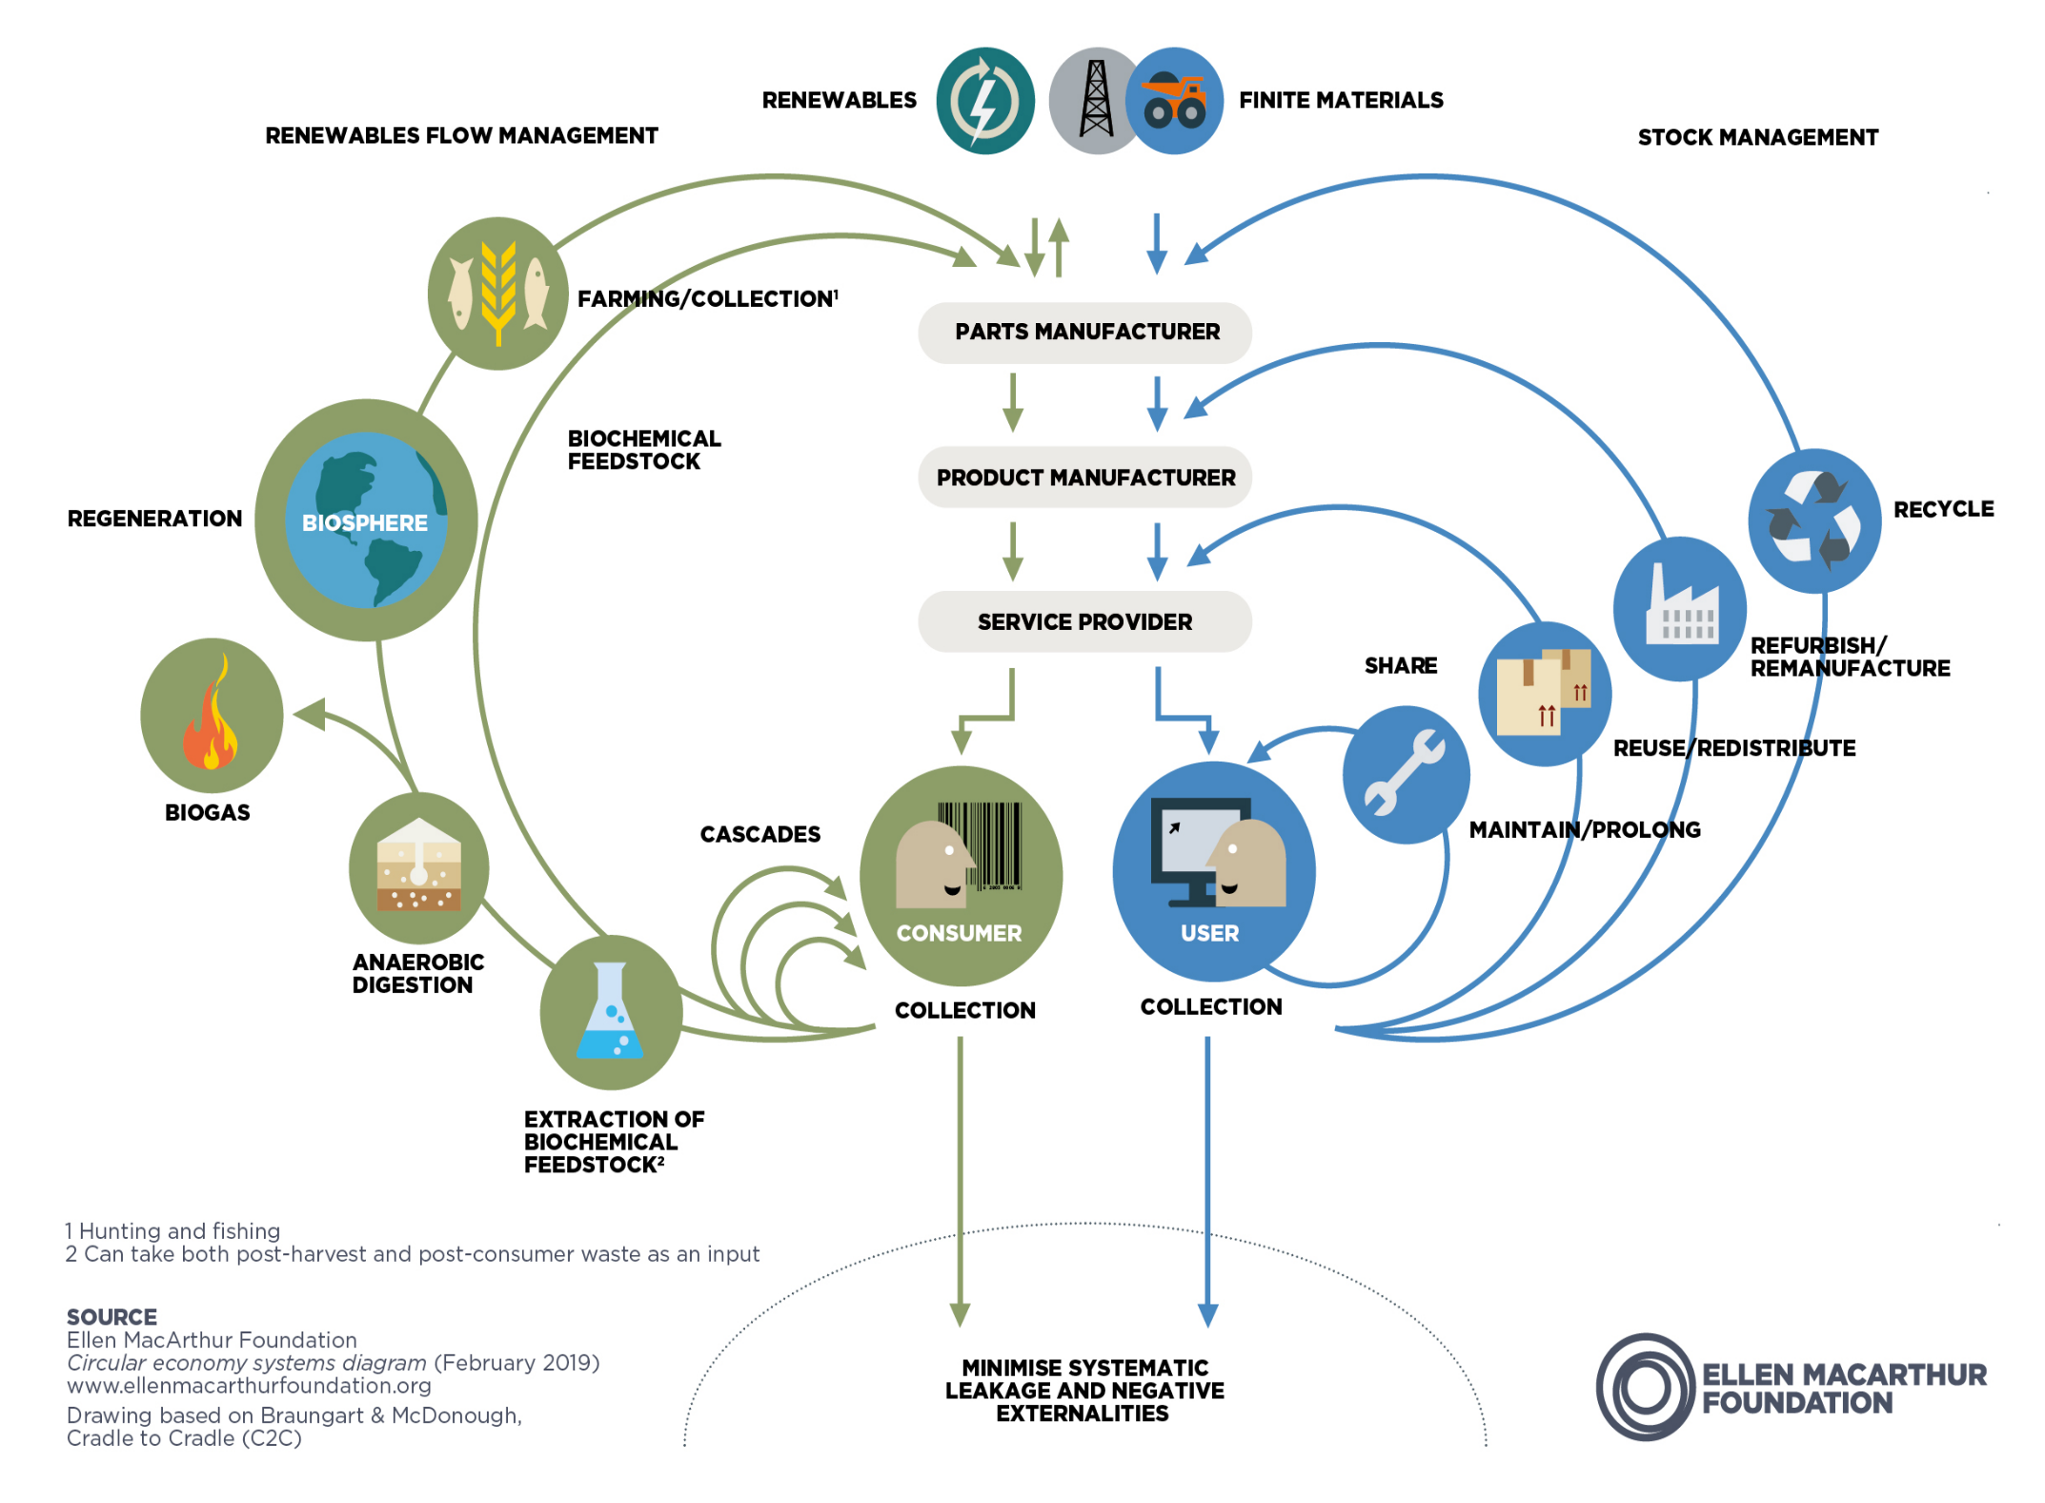
Technology and the Contemporary Environment
The Circular Economy
What is the Circular Economy?
https://www.youtube.com/watch?v=nrzwAxcU1bw

Slide 64
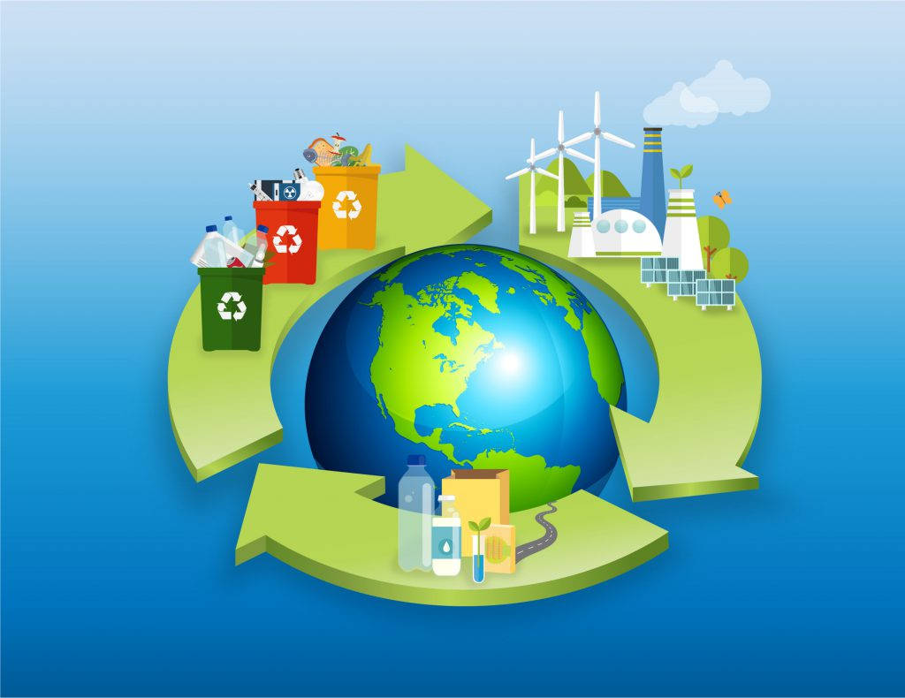
Technology and the Contemporary Environment
The Circular Economy
How the circular economy works
The circular economy is based on three principles, driven by design (elements):
Eliminate waste and pollution (Reduce)
Circulate products and materials (at their highest value) (Reuse)
Regenerate nature (Recycle)
The Circular Economy - Short Film
https://www.youtube.com/watch?v=XyNzYV4Q2HE

Slide 65
Technology and the Contemporary Environment
The Circular Economy
A circular economy is fundamentally different from a linear. In a linear economy we mine raw materials that we process into a product that is thrown away after use. In a circular economy, we close the cycles of all these raw materials. Closing these cycles requires much more than just recycling.
The definition is focused on system change which emphasis on: closed cycles, renewable energy and systems thinking.

Slide 66
Technology and the Contemporary Environment
The Circular Economy
Closed Cycles: Material cycles are closed following the example of an ecosystem. There is no such thing as waste, because every residual stream can be used to make a new product.
Renewable energy: The circular economic system is fed by renewable energy sources.
Systems thinking: Every actor in the economy (company, person, organism) is connected to other actors. Together, this forms a network in which the actions of one player influence other players.

Slide 67
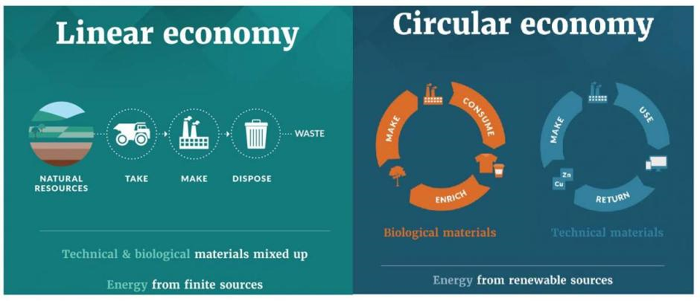
Technology and the Contemporary Environment
The Circular Economy
The linear economy does not price the cost of the enormous waste, pollution, and carbon emissions that are built into the system.
Circularity reduces both our demand for raw materials and the environmental impact of obtaining them.

Slide 68
Technology and the Contemporary Environment
The Circular Economy
When working on sustainability within a linear economy, the focus is on eco-efficiency. This is to minimize the ecological impact for the same output. This will extend the period which the system becomes overloaded.
Within a circular economy, sustainability is sought in increasing the eco-effectiveness of the system. This means that not only the ecological impact is minimized, but that the ecological, economic and social impact is even positive.

Slide 69
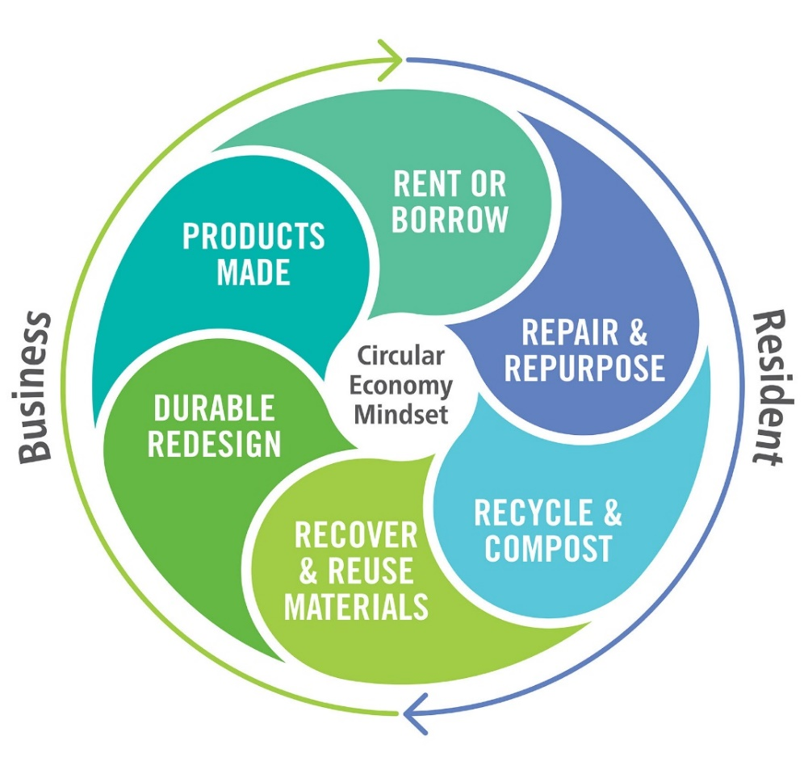
Technology and the Contemporary Environment
The Circular Economy
It entails redesigning products to be more durable, reusable, repairable, and recyclable, and therefore kept in circulation for as long as possible. Beyond product design innovations, it also means changing the way we consume and use goods and services, and rethinking consumerism as a society.

Slide 70
Technology and the Contemporary Environment
The Circular Economy
A circular economy offers a wide range of social, economic, and environmental benefits.
By optimizing the lifetime of our products and materials and designing out waste, circularity reduces both our demand for raw materials and the environmental impact associated with obtaining them.
The circular economy shrinks harmful activities such as carbon emissions, air pollution, and toxicity exposure, and increases positive actions such as habitat restoration, renewable energy, and cleaning the air.

Slide 71
Technology and Contemporary Environment
The Circular Economy
A circular economy offers a wide range of social, economic, and environmental benefits.
The circular economy also offers social benefits particularly in low-income economies, because integrating informal waste pickers into formal waste collection provides job security and fair wages.
Circularity also promises to deliver substantial economic benefits. Scaling up reuse, repair, remanufacturing, and recycling creates millions of jobs and stimulates innovation.

Slide 72
Technology and the Contemporary Environment
The Circular Economy
A circular economy offers a wide range of social, economic, and environmental benefits.
The circular economy also offers social benefits particularly in low-income economies, because integrating informal waste pickers into formal waste collection provides job security and fair wages.
Circularity also promises to deliver substantial economic benefits. Scaling up reuse, repair, remanufacturing, and recycling creates millions of jobs and stimulates innovation.

Slide 73
Technology and Contemporary Environment
The Circular Economy
A circular economy offers a wide range of social, economic, and environmental benefits.
Capturing and reusing critical materials such as rare earth metals helps make the economy more resilient to global supply chain shocks and ensures the world has the materials to create the renewable energy infrastructure it needs.
The circular economy could have a positive net effect on job creation provided workers acquire the necessary skills. The International Labour Organization already estimates a global net increase of jobs from 7-8 million by 2030 due to shifts towards circular economy.

Slide 74
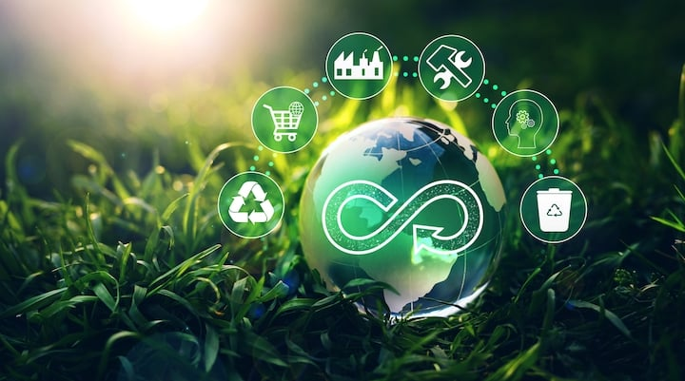
Technology and the Contemporary Environment
The Circular Economy
The Circular Economy and How it can help tackle Climate Change
https://www.youtube.com/watch?v=IKowI9nKonw

Slide 75
Technology and the Contemporary Environment
The Circular Economy
"Challenges and opportunities in the enabling environment and investment climate within the intersection of emerging technologies and circular economy.“ – The World Bank
There are millions of jobs connected with this linear, high-waste economy – many in low-income countries – and so any switch to a circular economy could not happen overnight.

Slide 76
Circular Economy and Emerging Technologies

Slide 77

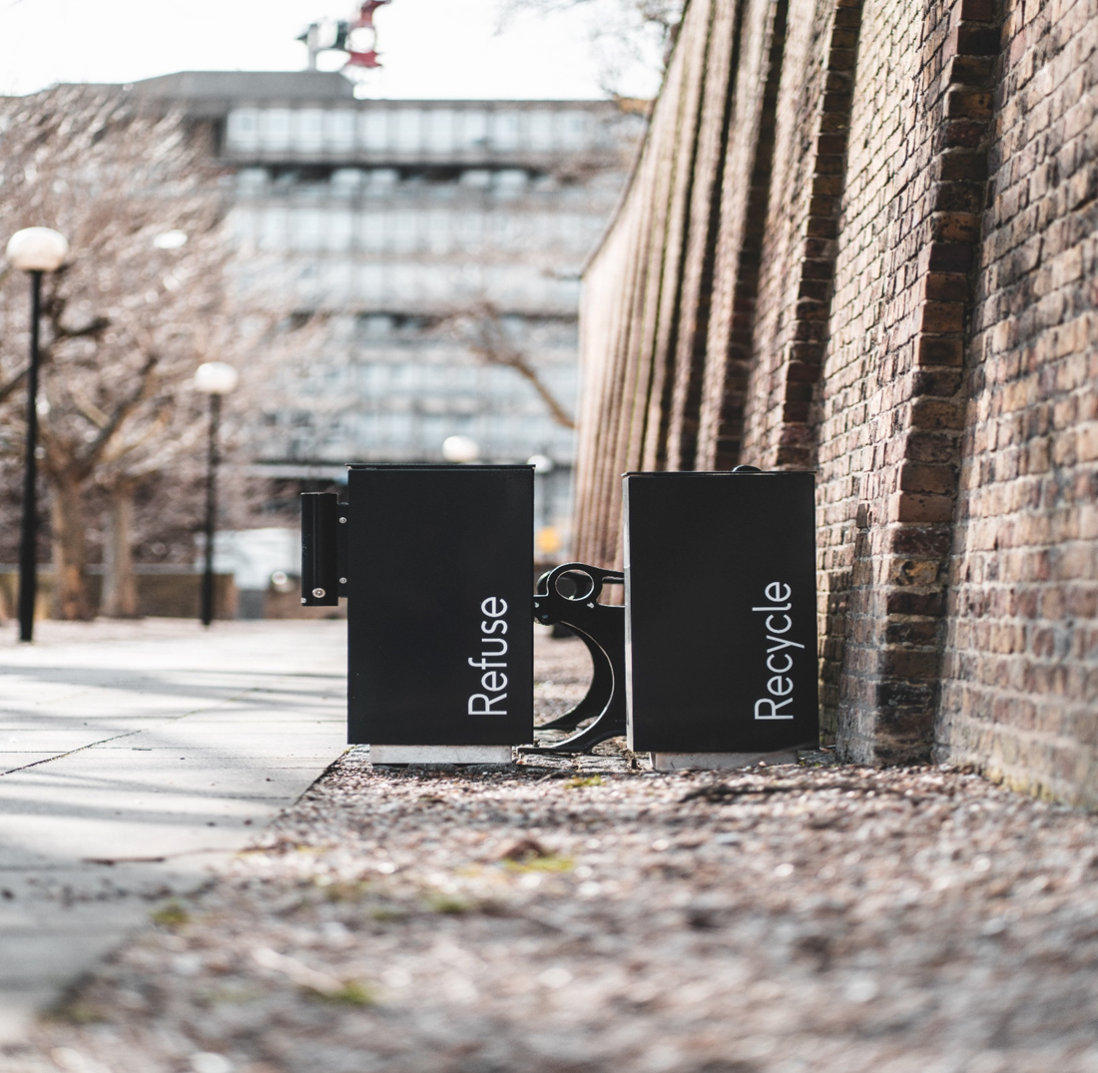
Technology and the Contemporary Environment
The Circular Economy
Circular economy - Together, let's rethink the place of technology
https://www.youtube.com/watch?v=CuKRLb0H0bI

Slide 78
Technology and the Contemporary Environment
The Circular Economy
The circular economy (CE) has the potential to capitalize upon emerging digital technologies, such as big data, artificial intelligence (AI), blockchain and the Internet of things (IoT), amongst others.
Chauhan, et al, 2022
●
“The vision for a circular economy is more than just a big idea. It is a systems solution framework that sets out a new way to design our global economy so that it flows and functions within planetary boundaries.”
Emma Elobeid, Editor, Ellen MacArthur Foundation

Slide 79
Technology and the Contemporary Environment
The Circular Economy
Imagination is the original innovation accelerator. It is essential if we are to solve big problems like climate change, waste, and pollution.
Emerging technologies and their convergence are having a transformational effect across global value chains. The range of these innovations across the digital, physical and biological technologies −from AI/machine learning, robotics, Internet of Things (IoT), bio electrochemical engineering, to sharing platforms, etc.

Slide 80
Technology and the Contemporary Environment
The Circular Economy
The play a crucial role in enabling circular business models by increasing efficiencies and reducing wastage; driving innovation by allowing new entrants in the markets; increasing information transparency allowing companies to gather insights; and enabling to move away from the use of traditional limited or resource/intensive materials (Accenture, 2020).
Efficient digital collaboration within a business ecosystem throughout a product’s different usage cycles is critical for enabling attractive circular business models and competitive user experiences.

Slide 81
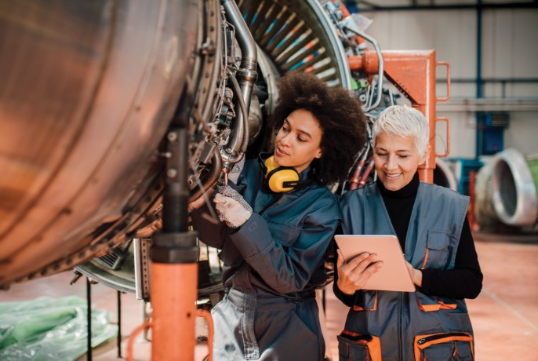
Technology and the Contemporary Environment
The Circular Economy
Organizations must leverage digital backbones to integrate more deeply into the operations of customers and partners. The goal is to establish identification and trust, emphasize value-in-use, rather than value-in-transaction, and launch new, innovative digitally-supported services. This will enable and improve the co-creation of value.

Slide 82
Conclusion

Slide 83
Technology and the Contemporary Environment
Conclusion
In any society, there will be those who raise alarms and those who ignore them
We are amassing a detailed knowledge of our dynamic planet
The challenge today is to support science so that we may judge false alarms from real problems and distinguish legitimate concerns from thoughtless denial
“Unless someone like you cares a whole awful lot, nothing is going to get better. It’s not.” – Dr. Seuss

Slide 84
Technology and the Contemporary Environment
Conclusion
It is crucial that people understand how human activities cause damage to our common environment, in both direct and indirect ways.
We must also design ways to prevent or effectively mitigate that damage.
Over the long term, our society can prosper only if it institutes a sensible limitation on its population and ensures that its use of natural resources is ecologically sustainable.
Now is the time to take full advantage of the wealth of opportunities in cities to create a system that can work long-term for the economy, society, and the environment.

Slide 85

Technology and the Contemporary Environment
QUESTIONS | SUGGESTIONS | COMMENTS

Slide 86

Technology and the Contemporary Environment
Do you have any questions?
Email: hugh.simmonds@torontomu.ca

